Slide 1
The Solar System’s Story is Revealed by Its Moons
What are their similarities and differences?
What are their origins?

Slide 2
Moons, also called Satellites, are of Two Basic Types
Natural Satellites
Artificial Satellites
A celestial body that orbits another, such as a planet
The body being orbited is either called the primary or the parent planet
There are 173 known natural orbiting satellites in the Solar System
A machine that orbits any celestial body, such as a star, planet, moon, minor planet or asteroid/comet
First artificial satellite was Sputnik 1, launched in 1957
These machines perform communications, observations and testing

Slide 3
This Presentation will deal with Natural Satellites
As of January 2012, per Wikipedia, there are over 200 minor-planet moons:
76 asteroids of Main Belt with moons (five with two each)
4 Jupiter Trojans with moons
39 near-Earth objects (two with two each)
14 Mars-crossers with moons
84 Kuiper Belt objects with moons

Slide 4
Different Shapes Reveal Origin
Spheroidal, ellipsoidal and ovoid (egg-like)
Irregularly shaped
Spheroids and ellipsoids are due to hydrostatic equilibrium and “binary” origin
Ovoid shapes are, in addition to the above, due to tidal locking and gravitational distortion
These types have normally regular orbits
Captured asteroids
Further fragmented by more collisions or by high energy arc sputtering
Found in more distant, inclined and eccentric orbits, including retrograde orbits

Slide 5
Hydrostatic Equilibrium Leads to Spherical Shapes
A fluid is in hydrostatic equilibrium when at rest or when flow velocity at each point is constant over time
This process occurred for planets and moons with symmetrically rounded shapes
The external forces of gravity are balanced by a pressure gradient force
Irregular surface features are due to thin, solid crust

Slide 6
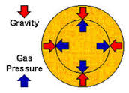
Spheroidal Fluid Shapes Forming in Free Space
P_{top} – P_{bottom} = - ρ x g x h = total force on fluid

Slide 7
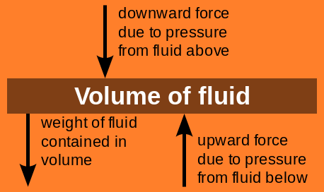
Force Summation for Hydrostatic Equilibrium
If the highlighted volume of fluid is not moving, the forces on it upwards equal the forces downwards

Slide 8
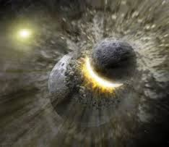
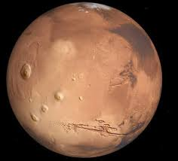
Irregular Moons Are Either Formed by Collisions or Arc Sputtering
Collisions with Debris and/or Mergers Between Bodies
Arc Sputtering, or Electrical Discharges Between Bodies or Strongly Charged Plasma

Slide 9
Solar System Moon Shapes

Slide 10
Relative Sizes of Largest Moons
Moons formed by hydrostatic equilibrium, by diameter
4000-6000 km: Ganymede and Callisto of Jupiter
Titan of Saturn
3000-4000 km: Moon; Io and Europa of Jupiter
2000-3000 km: Triton of Neptune
1000-2000 km: Rhea, Iapetus, Dione and Tethys of
Saturn; Titania, Oberon, Umbriel
and Ariel of Uranus; Charon of Pluto
250 – 1000 km: Enceladus and Mimas of Saturn;
Miranda of Uranus

Slide 11
Relative Sizes of Smaller Moons
All moons of planets, dwarf planets and minor planets from 10 to about 250 km are irregularly shaped, the same as asteroids and comets
As a comparison, the largest asteroids of the Main Belt have a range of sizes from 10 to 1000 km, with Ceres being the largest
The largest population of moons, in the millions, are under 1 km in size

Slide 12
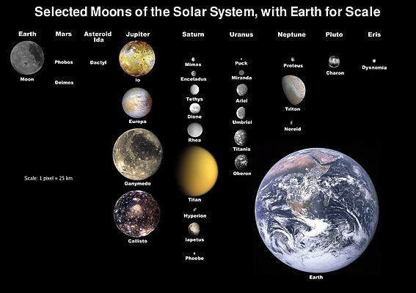
The Largest Moons Shown to Scale

Slide 13
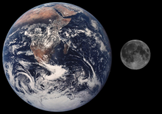
The Earth and Moon to Scale
The ratio of their diameters is 1737 to 6371 km, or 0.27

Slide 14
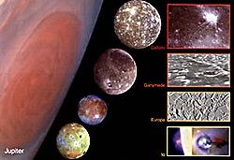
Jupiter and the Galilean Moons to Scale
The ratio of their typical diameters, using Ganymede, is 2634 to 69,900 km, or 0.038, almost a factor of 10 smaller than the Moon/Earth ratio

Slide 15
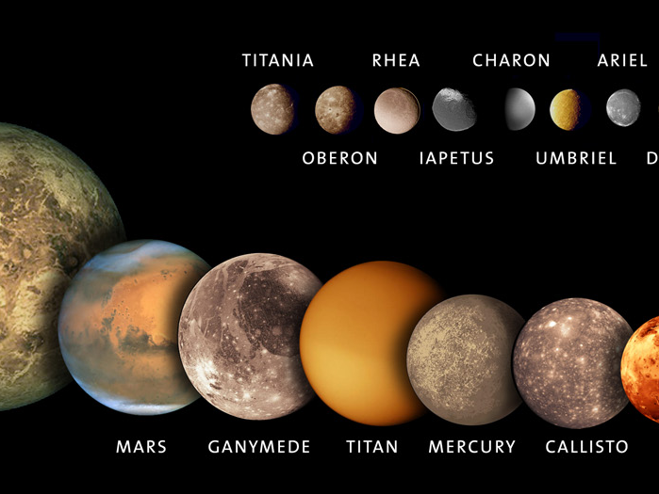
Relative Size of Solar System Bodies
Some moons scaled with Venus, Mars and Mercury

Slide 16
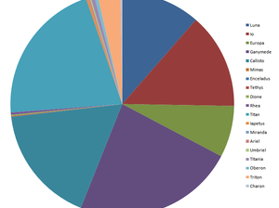
Relative Masses of Moons
The majority of mass of all the Moons is possessed by the eight largest: Earth’s Moon, Jupiter’s Galilean moons, Saturn’s Titan, Uranus’s Titania and Neptune’s Triton.
All the irregularly shaped natural satellites, even added together, would be too small to be visible at this scale.

Slide 17
Mass Ratios for the Moons
The mass ratios of other planets to their satellites differ by as much as 100 to 1000 times more than the Earth-to-Moon mass ratio, with the exception of Pluto and Charon.
This significant ratio difference is the root of an entirely different postulated origin: a combination collision and capture mode. For Earth/Moon, the “Giant Impact Hypothesis” was invented.

Slide 18
Orbital Characteristics
Orbital direction: prograde or retrograde
Orbital distance: regular moons are closer
Orbital plane: either inclined or aligned with
the primary’s equatorial plane and/or the average plane of the planetary orbits
Orbital shape: slightly to extremely elliptical
General trend for regular moons is prograde, closer, orbital plane aligned and less elliptical

Slide 19
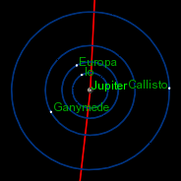
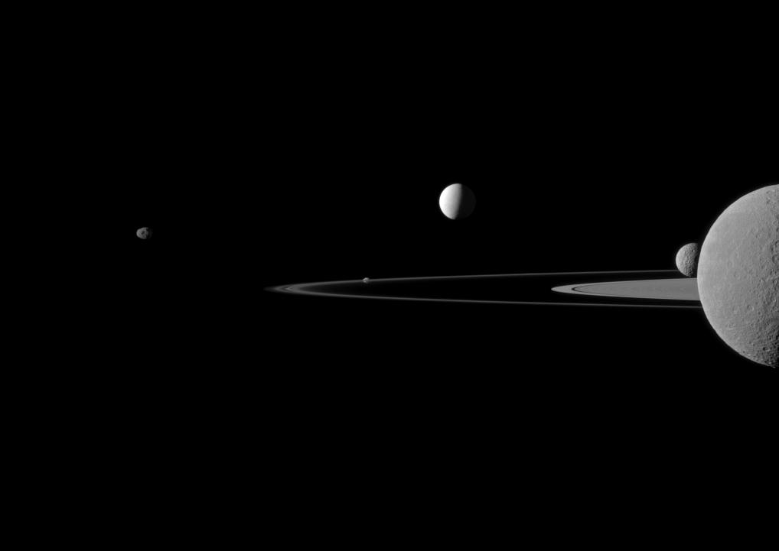
Ratio of Moons’ Orbital Radii to Planet’s Radius
Jupiter’s farthest Galilean moon, Callisto, has ratio of about 27
Saturn’s farthest regular moon,
Titan, has ratio of 20.98 (actual Cassini image shown)

Slide 20
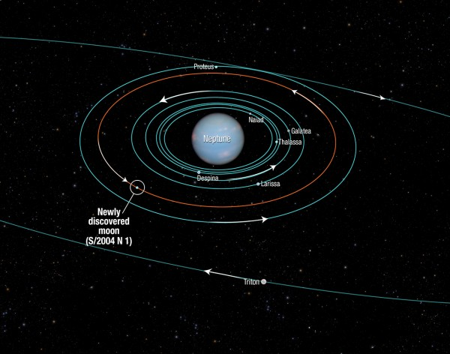
Mystery of Earth’s Moon’s Orbital Radius (Why is it so far away?)
Neptune’s farthest moon besides Tritonis, Proteus, with a ratio of 4.78. All other moons have smaller ratios.
Comparison of Moon’s Orbital Radius with Typical Outer Moons

Slide 21
Rotation of Moons
The larger moons are tidally locked
  The same side always faces the parent planet
  Gravity forces between the two bodies create crustal tides and resistance that slows the spin of both bodies, more slowly for the more massive planet
The outer, irregular satellites are too far away to become locked and normally have rotational periods

Slide 22
Compositions are Very Different
From mass and volume, density is computed
From moment of inertia, differentiation and solid/liquid cores can be determined
Primordial differentiation is the process of the separation of ices, silicate rocks and metallic cores into shells within the satellite interior
Crusts are always ices of CH₄, N₂, C0₂, NH₃, SO₂(Io) and H₂0, per atmosphere analyses, due to surface temperatures of 38°K to 134°K
The exception to these crusts is our Moon

Slide 23
Relative Densities and Internal Magnetic Fields Reveal the Structure
The highest mean densities range from 3.013 to 3.346 g/cm³ for Europa, Io and the Moon
Metallic iron cores are suspected, with the Moon having a liquid outer core
Normal rocky mantles are differentiated
Ganymede, though only 1.936 g/cm³, has a suspected outer liquid and inner solid core; it has a strong magnetic field of 719 nT, within Jupiter’s field of 1440 nT

Slide 24
Smaller Densities Produce Different Layered Mantles Covered with Icy Crusts and Sometimes Liquid Oceans
Densities in the range of 1.23 to 2.06 g/cm³ are typical of Rhea, Charon, Callisto, Titan and Triton
These moons have mantles of compressed silicate rocks and ices
Some mantles are covered with thick icy crusts, then a liquid ocean (where life could exist) and then a floor of tetrahexagonal ice

Slide 25
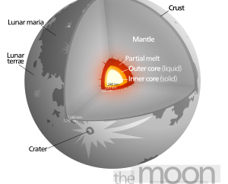
The Moon’s Internal Structure
Example of a high-density moon (3.346 g/cm³) with a crust, mantle and core similar to the terrestrial planet

Slide 26
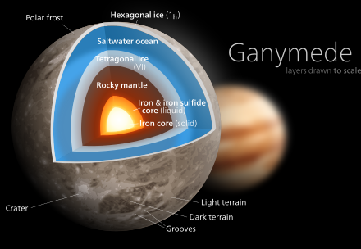
Ganymede’s Internal Structure
Example of an intermediate-density moon (1.936 g/cm³) with an unusually high magnetic field

Slide 27
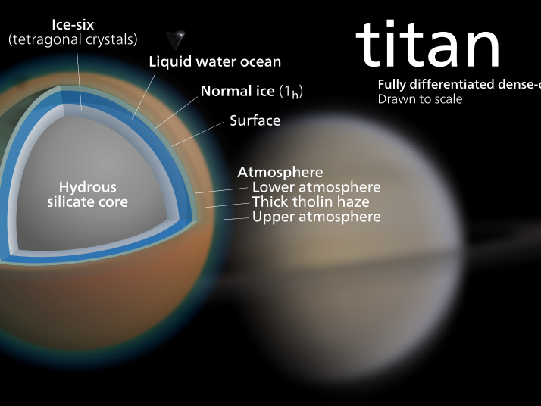
Saturn’s Titan Internal Structure
Example of a lower-density (1.880 g/cm³) moon having a liquid ocean, but an undifferentiated hydrous silicate core

Slide 28
Comparison of Other Densities
Pure water at 3.98°C. is 1.000 g/cm³
Limestone and granite are 2.6–2.7 g/cm³
Iron is 7.8 g/cm³
Lead is 11.3 g/cm³
Earth’s mean density is 5.52 g/cm³
Earth’s core is 13 g/cm³
Moon’s density is 3.346 g/cm³

Slide 29
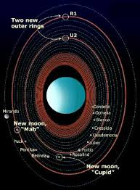
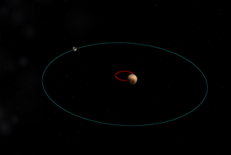
Anomalous Moons
Uranus’s moons have an orbital plane 90° to the average plane
Charon to Pluto have unusual high mass ratio, causing mutual tidal locking with exterior barycenter

Slide 30
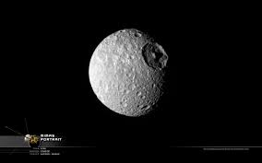
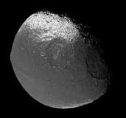
Mystery Moons
Iapetus has a bulging equatorial ridge, two-tone coloration and two large hexagonal craters
Mimas, moon of Saturn, has a deep hexagonal crater almost 1/3 its diameter

Slide 31
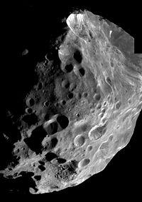
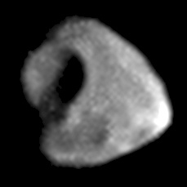
Unexplainable(?) Impossible Impact Cratering and Smooth Scalloped Rims
Close-up image of Jupiter’s 49-km Thebe, showing a crater obviously not created by an impact, but by high energy plasma discharge
Close-up image of Saturn’s 200-km Phoebe, by Cassini, showing erosion by plasma arcing

Slide 32
The Moon Enigma: Earth’s Moon is More Similar to a Planet
Moon is the only satellite whose Sun’s gravity force is greater than its primary’s
Moon’s orbit is inclined 5.1° to the elliptic and not in Earth’s equatorial plane
Ratio of Moon’s orbital radius to Earth’s radius is almost 10 times larger than all other satellites
Their mass ratio differs by more than 100 to 1000 times those of other satellites
Moon’s internal structure and crust are quite different from that of the icy outer satellites
Moon’s distance from its primary has no comparison with other regular satellites
These anomalies inspired the “Giant Impact Hypothesis”

Slide 33
A Postulated Pole Shifting of Europa’s Icy Crust
Europa has either a thick ice or a thin ice crust, sitting on a subsurface, highly conductive, salty ocean
From magnetic field data from the Galileo orbiter, portions of its crust have flipped about 80°; this pole wandering event could have caused plate tectonics and erupting liquid water
The surface is very smooth, with hardly any cratering, which is a sign of a young, active geology

Slide 34
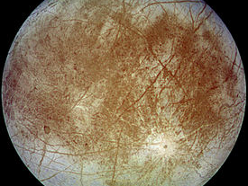
Europa has an Anomalous, Youthful, Less Cratered Surface
Dark streaks crisscross the entire globe. Could these streaks be cracking in the icy crust caused by stresses when the subsurface ocean shifted, as one unit, due to electromagnetic phenomena?

Slide 35
The Moons Do Tell the Truth
Jupiter’s moons told Galileo that Earth and man were neither geocentric or anthrocentric
Our Moon’s face, as viewed by telescopes, reveals other worlds also having mountains and seas
Eclipses and phases of the Moon show us that celestial bodies are mostly spheroidal and exist in suspended orbits in the ether of space
The falling Moon convinced Newton that a hidden force, gravity, is a universal law

Slide 36
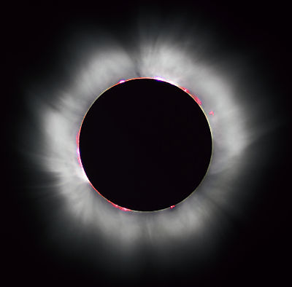
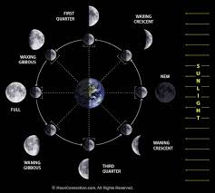
Observational Qualities of Our Moon
Lunar and solar eclipses (the 1999 total solar eclipse is shown)
The Moon’s Phases: man’s monthly celestial clock

Slide 37
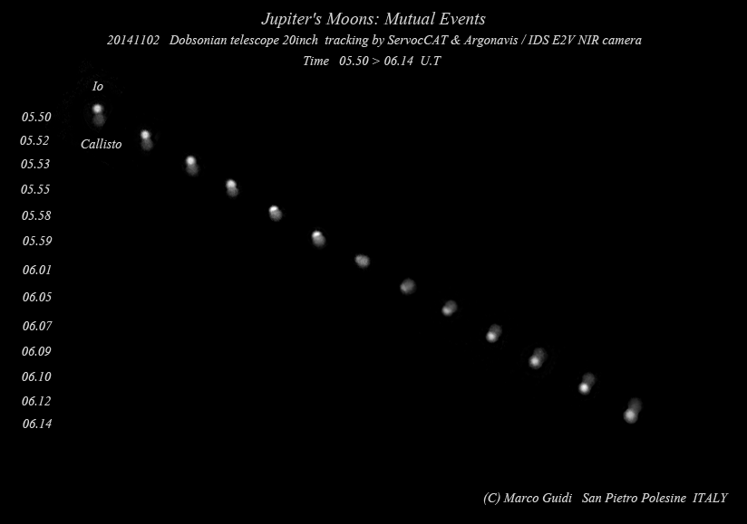
Occultation of Io and Callisto, as shown by NASA’s APOD
Orbital plane crossings of Jupiter’s Galilean moons are easily seen when Earth is aligned edge-on every five to six years

Slide 38
Conclusions of This Study of Moons
The moons have a rich diversity of shapes, sizes, masses, densities, structure, orbital distances, motions, compositions and surface features; and numerous unresolved questions
Their relative size distribution reveals that the power law operates for nature’s production of these celestial bodies → as the size decreases, their populations increase, between being proportional to exponential

Slide 39
Formation and History of Regular Moons
Their formations are uncertain and perhaps varied; three models stand above the others
The most accepted is the accretion of orbiting rings of matter inside a gravitationally formed proto-body disk.
Moons are formed and captured by the forces of highly energized magnetic circuits and electric currents that still exist but presently do not knowingly dominate.
Bodies are released equatorially from the interiors of primaries, due to an imbalance of electromagnetic forces. Moons such as Io, Europa and Titan could be the most recent ones resulting from this model.

Slide 40
Formation and History of Irregular Moons
The models for their formation are highly disputed. Are they the incomplete accreted bodies of primordial matter of the proto-star disk, or are they the result of arc sputter and collisions after bodies condensed, differentiated and solidified? If they are the debris of interacting bodies what is the true mechanism:
Collisions or breaking apart inside Roche Limit
AND/OR
Sputtering of planetary surfaces by high-energy discharge arcing of plasma currents?

Slide 41
Important Questions to Consider
What can cause hexagonal craters on the moons of Mimas and Iapetus?
What can cause the smooth, scalloped cratering that is found on most irregular satellites?
How can impact craters exist that are almost one third the size of the impacted body?
How can Uranus’s spin axis and its satellites’ orbital axes be both 90° to the average planetary plane? The accretion theory is invalidated.

Slide 42
Keep Questioning
It Exercises Your Mind
Why do irregular moons look like and feel like your typical asteroid and comet? Are both arc sputtering and capture modes the real reasons for their creation?
If the icy crust of Europa can rotate about its spin axis, then is it quite possible for other bodies to do the same, having a liquid layer including a liquid core of iron? Did Earth’s mantle ever shift?
Why does the Earth’s Moon have all the features of a terrestrial planet and why is it held in its orbit by the Sun’s gravity field and not Earth’s?

Slide 43
Catastrophism Verses Uniformitarianism
What is the state of our solar system?
Hopefully the position of Earth 1 AU from the Sun is secure and stable. But, instability of the system keeps appearing:
Young moons such as Titan, Io and Europa
Long and short period comets
Rings of dust around the outer planets
All the above should have dissipated and/or disappeared millions of years ago.
Plasma arc discharges are seen on surfaces of most moons and “wannabe” moons, such as asteroids comets and KBOs.
Planet Mars is a primary example of major arc sputtering; no type of collision or Earth-type erosion can explain what is seen.

Slide 44
Keep Mooning Around
Stay current with NASA and ESA space probe data.
Please ask yourself: can gravity give us all the answers? Or are electromagnetic effects on celestial bodies also required? In fact, are EM effects the primary ones?
Have fun observing those moons in the sky.
Have even more fun wondering and anticipating how the solar system works and what all those newly discovered moons can tell us.

Slide 45
Major References and Sources
Wikipedia; the Moon, Natural Satellites and Hydrostatic Equilibrium
NASA website, including news, missions and multi-media
The Electric Sky by Donald E. Scott
The Electric Universe by Thornhill and Talbott
Asimov on Astronomy by Isaac Asimov
Cataclysm! Compelling Evidence of a Cosmic Catastrophe by Allan and Delair

